Slide 1
Good Practice in Efficient Action Recognition
(resubmission)

Slide 2
Paper claims
100x speed-up for motion feature extraction leads to only 3-4% worse accuracy on a number of datasets
Confirmed: Fisher vectors work consistently better than histograms and VLAD
Paper provides the computation time breakdown

Slide 3
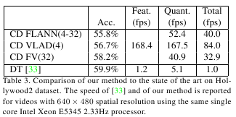
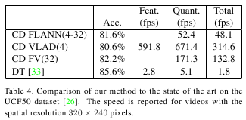
Results

